Slide 1
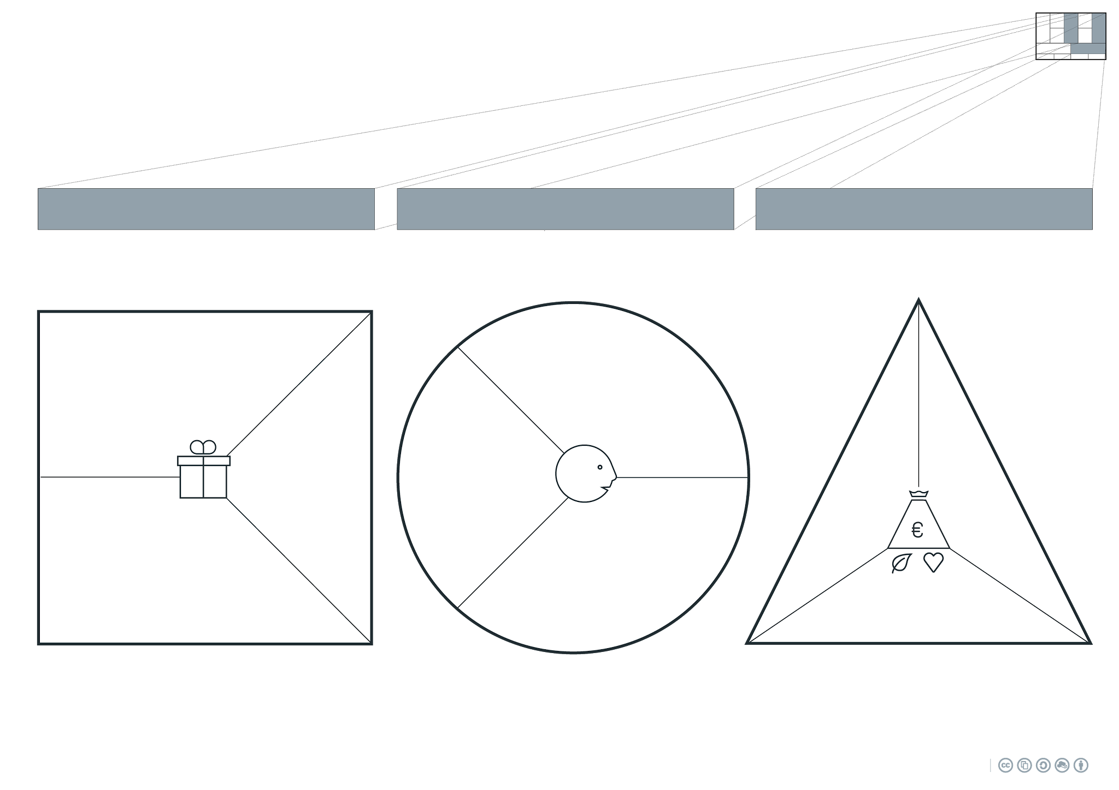
As a result of a big renovation project, a big pile of materials becomes available to be circulated back into Amsterdam.
By providing the material passports the customer can easily predict if the material is fitting for their project.
We create great value for customers who need materials for their projects, where the materials are easily discoverable in ordinary homes (metals, doors, hinges).
Customers who are working around Amsterdam.
The biggest goal is not to make a profit on the materials, but to prevent costs in transport.
Applications:
Workshops:
Production sector, working with metals, wood and based around Amsterdam.
Artists:
Culture & Education, producing and selling their arts around Amsterdam.
This BMC aims for payments in contact, time and money (or the reduction of spendings)
⧠ Product
⧠ Service
⧠ Certification
⧠ Training
⧠ Maintenance
⧠ ...
Direct Sales
Materials
These are materials of genuine Amsterdam homes for an affordable price.
By making the materials publicly available, reduces the costs of the material being transported to the recycling plant.
Marketplace model The Alliantie places a ‘product’ or material on the virtual marketplace with the correct material passport.
Users can pay for the material and pick them up at the designated time/place.
Housing Corporations:
Real estate sector around Amsterdam/Randstad, that uses the same types of CHI*.
...
*CHI = Central Heating Installation

Slide 2
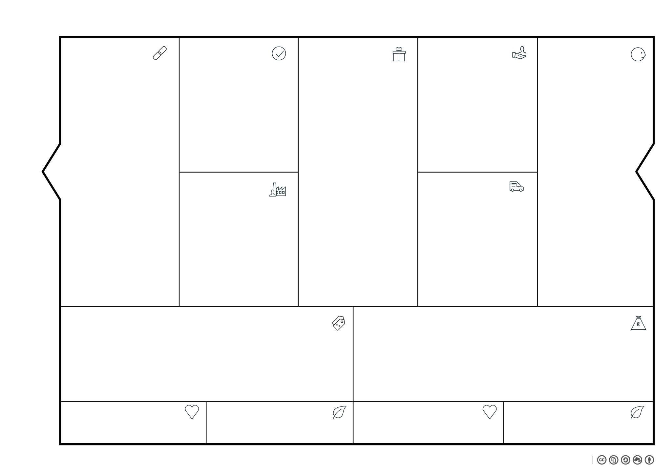








Duration: Renovation project de Alliantie
Timespan : Start Renovation project de Alliantie
Material sourcing
Wide range of materials from Amsterdam
Community
Recurring customers who know what we sell.
Workshops in need of wood/metal and work on circulation projects.
CV Ketel Recycling Pick up remaining lot to recycle.
Create Material Passports
Short term:
Material
Pick-up
Long term:
Contact
Service
MP
Connect resources to customers
Cheaper provided parts to stimulate circulation
Artists who produce educational pieces in and around Amsterdam.
Isover
Is essential for removing glasswool
No ‘blind’ customers =>
Material passports
(MP)
Housing Corprations
Who use the similar/same devices and are in need of spare parts.
Circular Challenge Team 3
Managing Sales
(money/time)
Setting up ‘Martketplace’
Hosting ‘Marketplace’
Storing/transporting unsold Parts
Reduce in transport costs
Material-dependant compensation
‘Old’ materials
Paint & rust on materials
Remanufacturing materials
Community that works towars the same goal
Materials are recirculated/remanufactured

Slide 3
Materials | Transport | Production | Packaging | Sales
This BMC De Alliantie

